Slide 1
CHAPTER 19 – THE BEAN COUNTER PROGRAM

Slide 2
PRELIMINARIES
Example from Chapter 18
  Kick it up a notch
  Build as We Go
Recall
  Use a basic text editor; fancy formatting will confuse the web browser
Filename extension should be .html
  The operating system knows the file will be processed by a web browser
First line & last lines respectfully
  <html> , </html>

Slide 3
PRELIMINARIES (CONT'D)
Enclose JavaScript text in <script> tags
  <script language="JavaScript">
  </script>
Once saved, find file on computer and double click it
  Web browser should open file and display the page you created

Slide 4
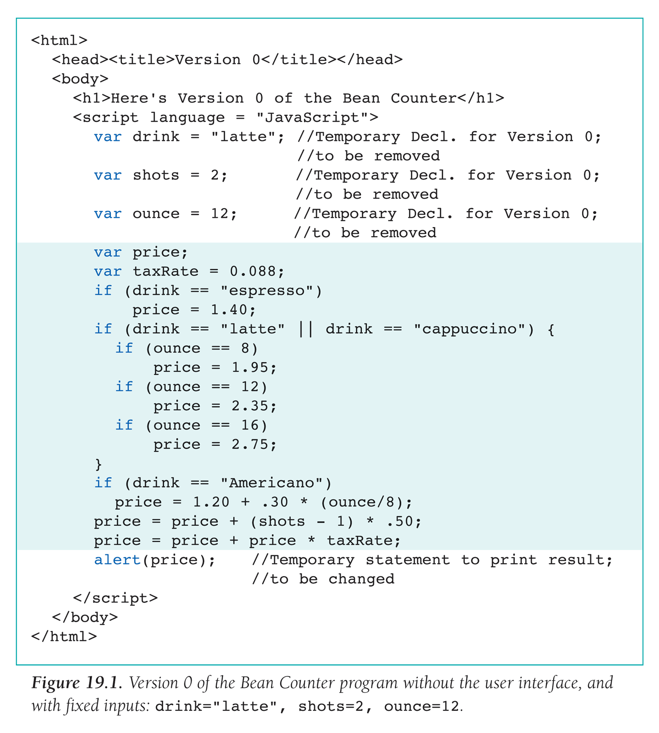

Slide 5
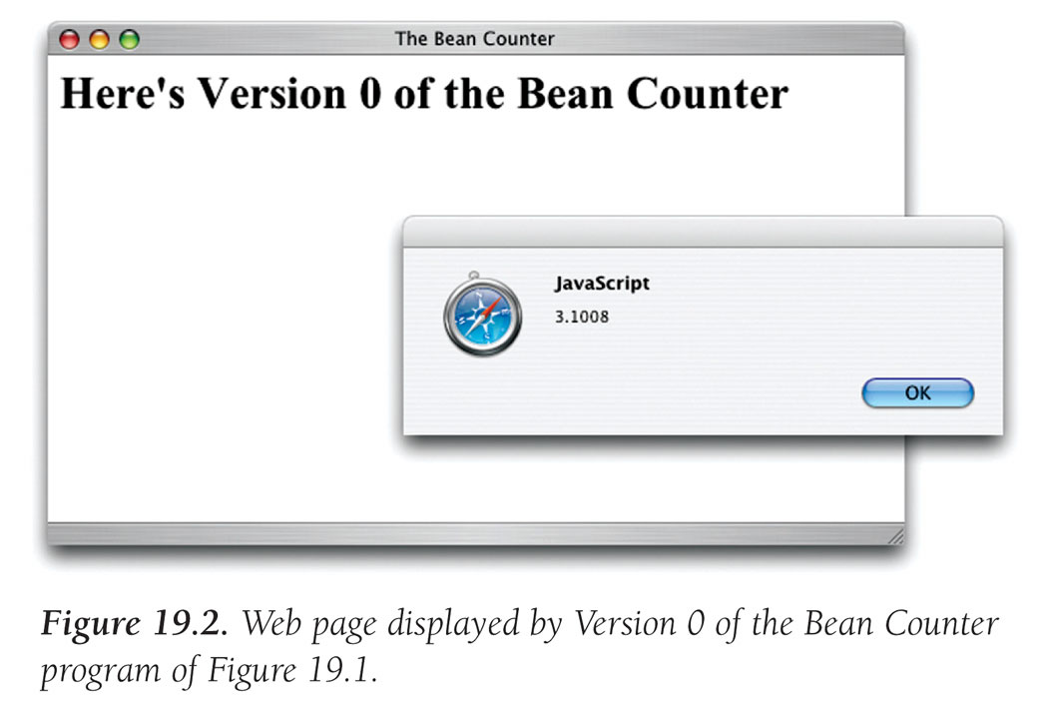

Slide 6
WHAT IS A GUI?
GUI = Graphical User Interface
  User has interaction with the program
We can use a table…
  Tables give us control over where information is displayed on a page
  <table>
  <tr>
  <td> </td>
  …
  </tr>
  …
  </table>

Slide 7
Interacting with a GUI
  Input facilities like buttons and checkboxes are known as elements of forms
  Form tags <form> and </form> must surround all input elements
  Form tag has name attribute:
      <form name = "Bean">
      </form>

Slide 8
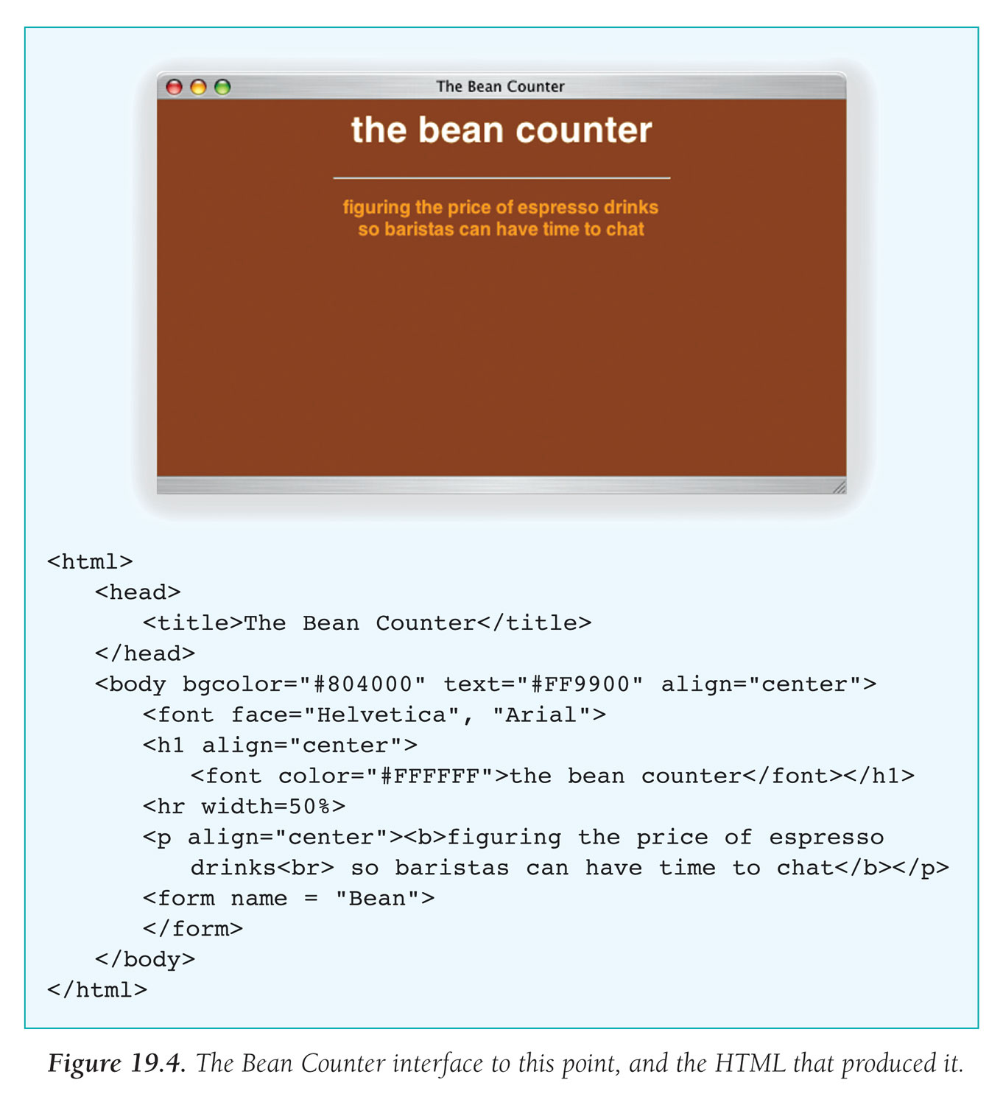

Slide 9
EVENTS & EVENT HANDLERS
GUI inputs being used cause an event to occur
  Event is an indication from the computer (Operating System) that something just happened
  User clicking on command button causes "click event"
Event handler is program that performs task in response to event

Slide 10
THREE INPUT ELEMENTS
Button
<input type=button value="label“ name="identifier" onClick="event_handler" />
    value gives text to be printed on the button
    identifier is the name of the element
    onClick gives event handler (JavaScript instructions)
    Button image is placed in next position in text of HTML document

Slide 11
THREE INPUT ELEMENTS
Text Box
  Used to input or output numbers or words
<input type=text name="identifier" size=6
onChange="event_handler" />
    identifier is the name of the element
    onChange gives the event handler's JavaScript instructions
      These program instructions are performed after user enters text
    Text input image is placed in next position in text of HTML program

Slide 12
THREE INPUT ELEMENTS
Radio Button
  Gives a selection of preprogrammed settings
  <input type=radio name="identifier"
  onClick="event_handler" /> label text
    Identifier is the name of the element
      A group of radio buttons use the same name
    label text is shown beside the button
    onClick gives the event handler
      When user clicks button, center darkens (indicating it is set), other radio buttons are cleared, and the instructions of the event handler are performed
    Radio button image is placed in the next position in the text of the HTML document

Slide 13
CREATE THE GUI
Bean Counter program is mostly a table of buttons
Algorithm for building the table:
  Create a button table
    Program HTML for a table with a generic button in each cell. Easy to do with Copy/Paste
  Delete two buttons
    Two cells should be empty. Don't delete the cells

Slide 14
  Insert text box
    Replace button for last cell with a text control
  Label the buttons
    Set the value attribute of each button so the label is correct
  Primp the interface
    Check and adjust where necessary

Slide 15
CREATE A BUTTON TABLE
  <td>
  <input type="button" value="b" onClick = ' ' />
  </td>
  "b" is a placeholder for the button label (we'll fix in Step 4),
  and ' ' is a placeholder for the event handler we'll write later
  Make four copies of the cell and surround them by row tags
  Make four copies of the row and surround them by table tags
  Save the page and review
  Change default left-justification to center—surround the table with <center> </center> tags

Slide 16
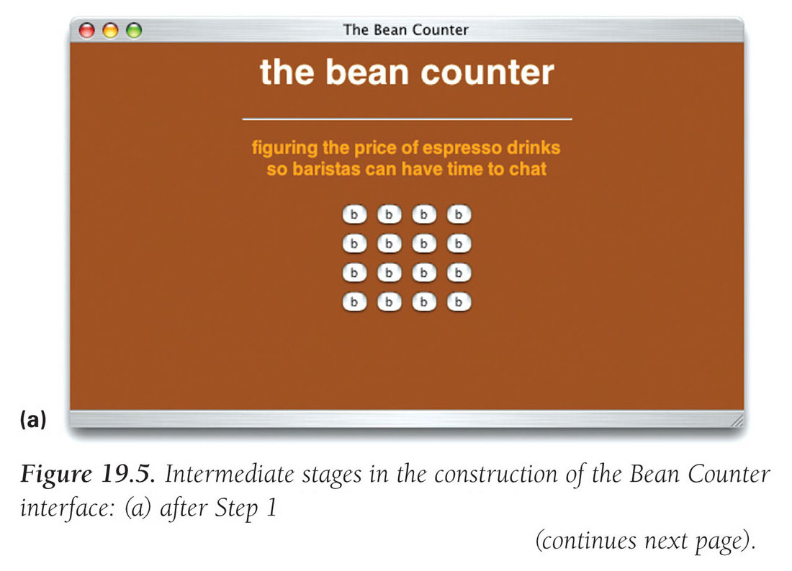

Slide 17
DELETE THE TWO BUTTONS
In row 2, cell 4, and row 4, cell 2, remove the <input… />
  These cells must be empty
  Cell can be empty but must still be surrounded by <td></td> tags to be a cell

Slide 18
INSERT THE TEXT BOX
Name the text box "price" because that's the information that will be printed
Window should be 5 characters wide because no combination of drink inputs will result in a price of more than 4 digits plus decimal point
onChange needs a placeholder
Button in row 4, cell 4, should be replaced by
  <input type="text" name="price" value="0.00" size="5" onChange=' ' />

Slide 19
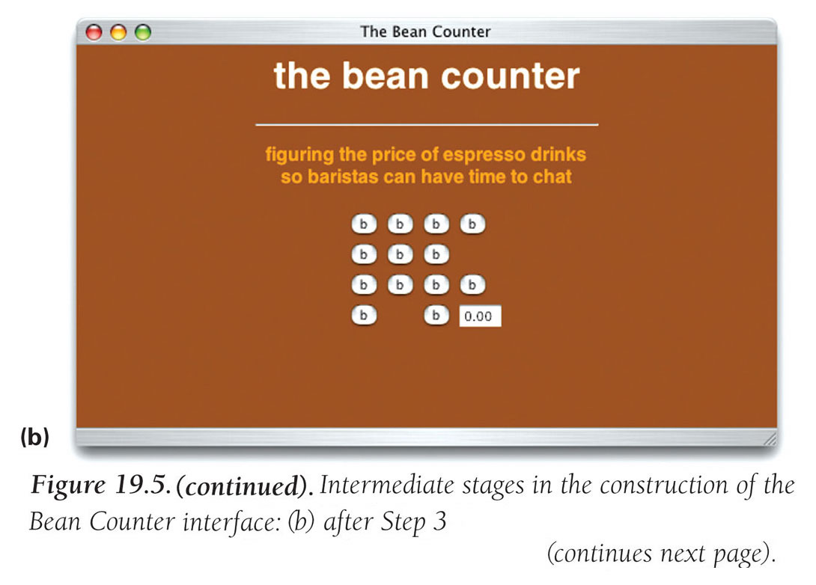

Slide 20
LABEL THE BUTTONS
Pass through cells and change the value attribute of each button from "b" to its proper label
  First column is number of shots (1, 2, 3, 4)
  Second column is sizes (S, T, G)
  Third column is the drinks (ESPRESSO, LATTE, CAPPUCCINO, AMERICANO)
  Fourth column is if we need to CLEAR an entry, TOTAL the order and finally the price

Slide 21
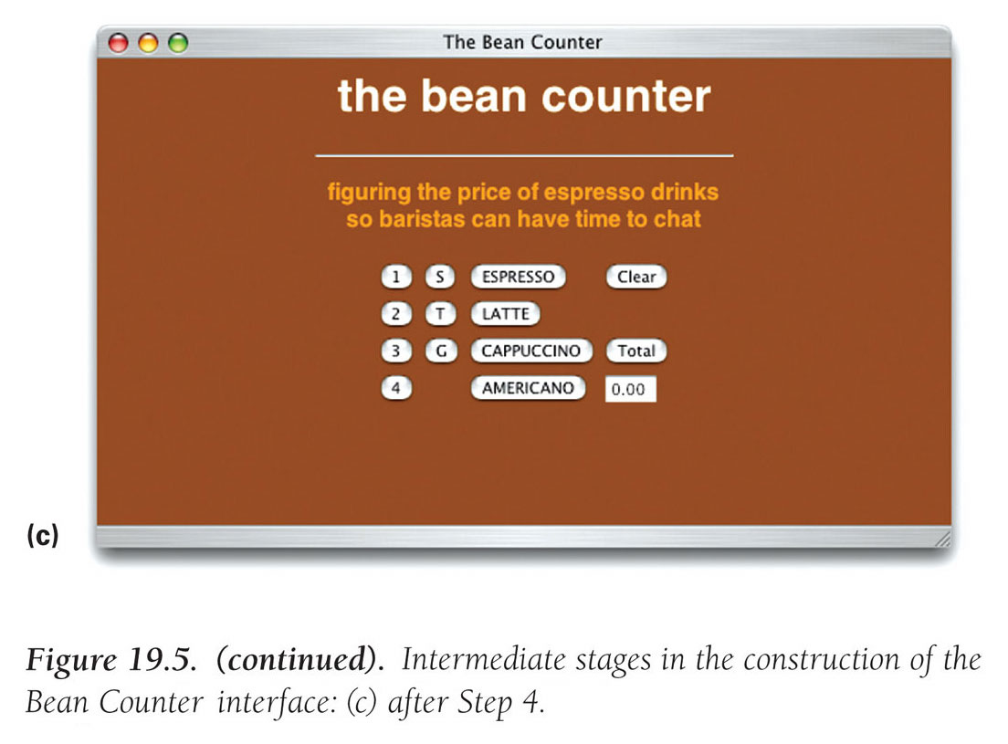

Slide 22
PRIMP THE INTERFACE
Notice that the buttons are left-justified in the columns
  Buttons in last two columns should be centered
  To revise ESPRESSO entry:
    <td align="center">
    <input type="button" value=" ESPRESSO " onClick=' ' />
    </td>
Give table a background color
    <table bgcolor="#993300">

Slide 23
PRIMP THE INTERFACE (CONT'D)
Add a border around the table as a whole
  Make a big one-cell table and make our table the table data for that new table
    <table border="2">
    <tr>
    <td>
    /* Existing table goes here */
    </td>
    </tr>
    </table>
Outline the price box with red
  <td bgcolor="red">

Slide 24
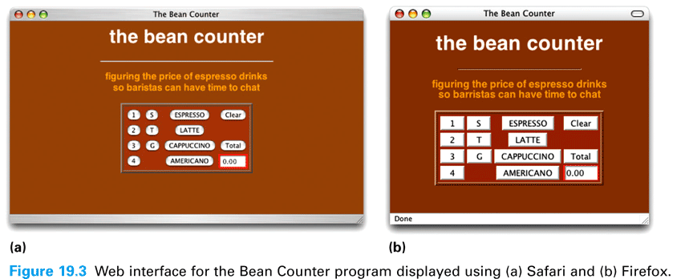

Slide 25
EVENT-BASED PROGRAMMING
Something should happen as each button is clicked
  Only in response to user-caused events
Define in JavaScript the actions to be performed when each button is clicked

Slide 26
THE ONCLICK EVENT HANDLER
onClick is the event-handling attribute for the Total button
Insert the price computation code inside the quotes for the onClick attribute
It becomes the onClick event handler

Slide 27
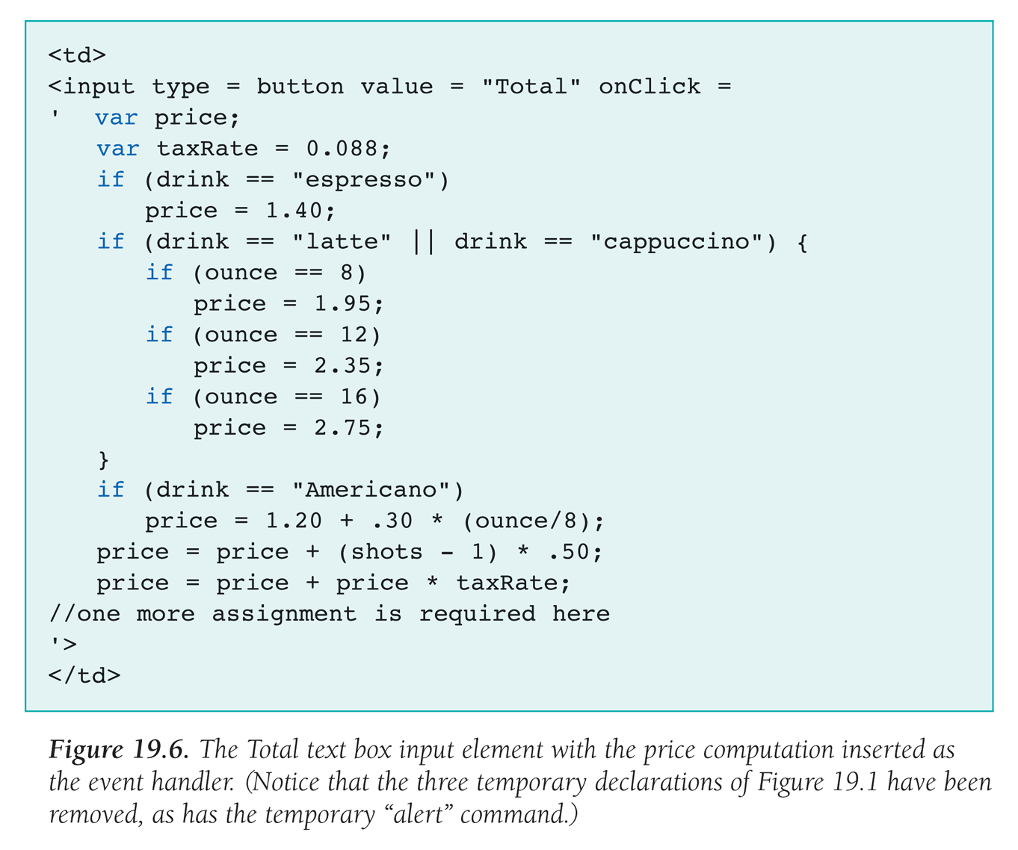

Slide 28
CLICK EVENT
When the barista clicks on the Total button, it causes a click event in the browser
The browser looks for the onClick event handler in the Total button input tag
Browser runs those instructions, then waits for the next event

Slide 29
SHOTS BUTTON
In each case, ask what action should be performed when a particular button is clicked
For the first column, specify number of shots
  Clicking on the 1 button should cause shots variable to have value 1
    <td>
    <input type="button" value="1" onClick='shots = 1' />
    </td>
  Clicking on the 2 button assigns shots the value 2, etc.

Slide 30
SIZE AND DRINK BUTTONS
Size buttons assign the ounce variable the appropriate value: 8, 12, or 16
<td>
<input type="button" value=" S " onClick='ounce = 8' />
</td>
Drink variable gets the name of the drink quoted
<td align="center">
<input type="button" value=" ESPRESSO "
onClick=' drink = "espresso" ' />
Single quotes surround the assignment statement, which uses double quotes
  Remember that string literals are case-sensitive

Slide 31
CLEAR BUTTON AND INITIALIZATIONS
Clicking on Clear button should reset all variables to their initial values
We have not declared or initialized those variables yet
Place declarations at start of JavaScript body, enclosed in <script> tags
<script language="JavaScript">
var shots = 1;
var drinks = "none";
var ounce = 0;
</script>

Slide 32
CLEAR BUTTON AND INITIALIZATIONS (CONT'D)
Clear button makes the same assignments as the initialization statements for each variable
<td>
<input type="button" value="Clear" onClick='
shots = 1; drink = "none"; ounce = 0;
document.Bean.price.value = "0.00" ' />
</td>
this HTML doc
  form attribute GUI/element
input

Slide 33
REFERENCING DATA ACROSS CONTROLS
When we want a statement in one element to change a value in another element, we must tell the browser how to navigate among the elements
Use the dot operator
  Provides a means of navigation to the proper object
    object.property selects the property of the object
    document.Bean.price.value = "0.00"

Slide 34
CHANGING THE WINDOW
Input elements are for both input and output
  When the value is reassigned, the window displays the new value, acting as output
Displaying the Total
  Total event handler outputs price
  document.Bean.price.value = price;

Slide 35
CRITIQUING THE BEAN COUNTER
Numbers versus Money
  Final price is shown as number, not currency
  Use Math.round to round to two decimal places
  Trailing zeros will be dropped, but we won't worry about it
Organization
  The design and organization makes sense for its application
Feedback
  There is no feedback about current settings of variables
  We could add a window above each column giving the current setting

Slide 36
RECAP OF THE BEAN COUNTER APPLICATION
Referencing variables
  Placed variable declarations inside the <script> and </script> tags
  Referenced data as variables local to a handler (taxRate), as variables global to all handlers (drink), and as a variable/attribute in another element (document.Bean.price.value)

Slide 37
RECAP OF THE
BEAN COUNTER APPLICATION (CONT'D)
Program and Test
  Incremental process
  Produced minimal HTML program, and tested
  Added skeleton table, and tested
  Improved table one feature at a time and tested
  Wrote JavaScript to solve one event handler at a time
    No complex tasks
    Continual testing spots errors immediately

Slide 38
RECAP OF THE
BEAN COUNTER APPLICATION (CONT'D)
Assess the Program Design
  Critiquing how well the solution fulfilled the need for which it was written
  Software should perfectly match the solution requirements

